Slide 1
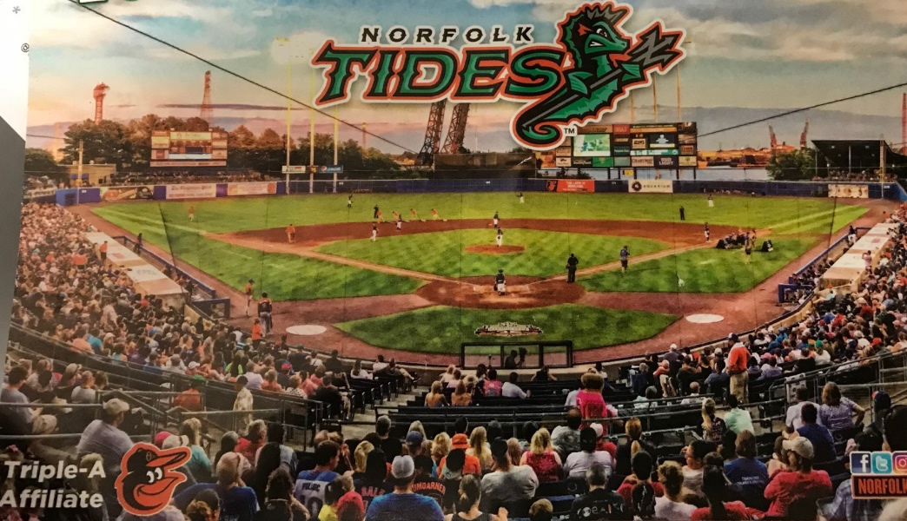
ASNE Tidewater Section Night at the Norfolk Tides Tuesday July 24 starting at 5:00pm
Doubleheader against the Syracuse Chiefs . Game 1 starts at 5:05pm and goes 7 innings. Game 2 will also be 7 innings.
Dinner in the Picnic Area 7:20pm – 8:50pm
Picnic Area is covered so this event happens rain or shine
Menu will be Fried Chicken, Pork BBQ, Italian Sausage, All –u-Can Eat Hot Dogs, potato salad, chips, watermelon, cookies and sodas. Beer available for purchase.
Sign up on the ASNE-TW website
Adults and Kids over 8 - $30
Kids 2-8 $27
Reservation cutoff is Tuesday July 17 at Noon
More information will be provided on pre-game ticket distribution

